Slide 1


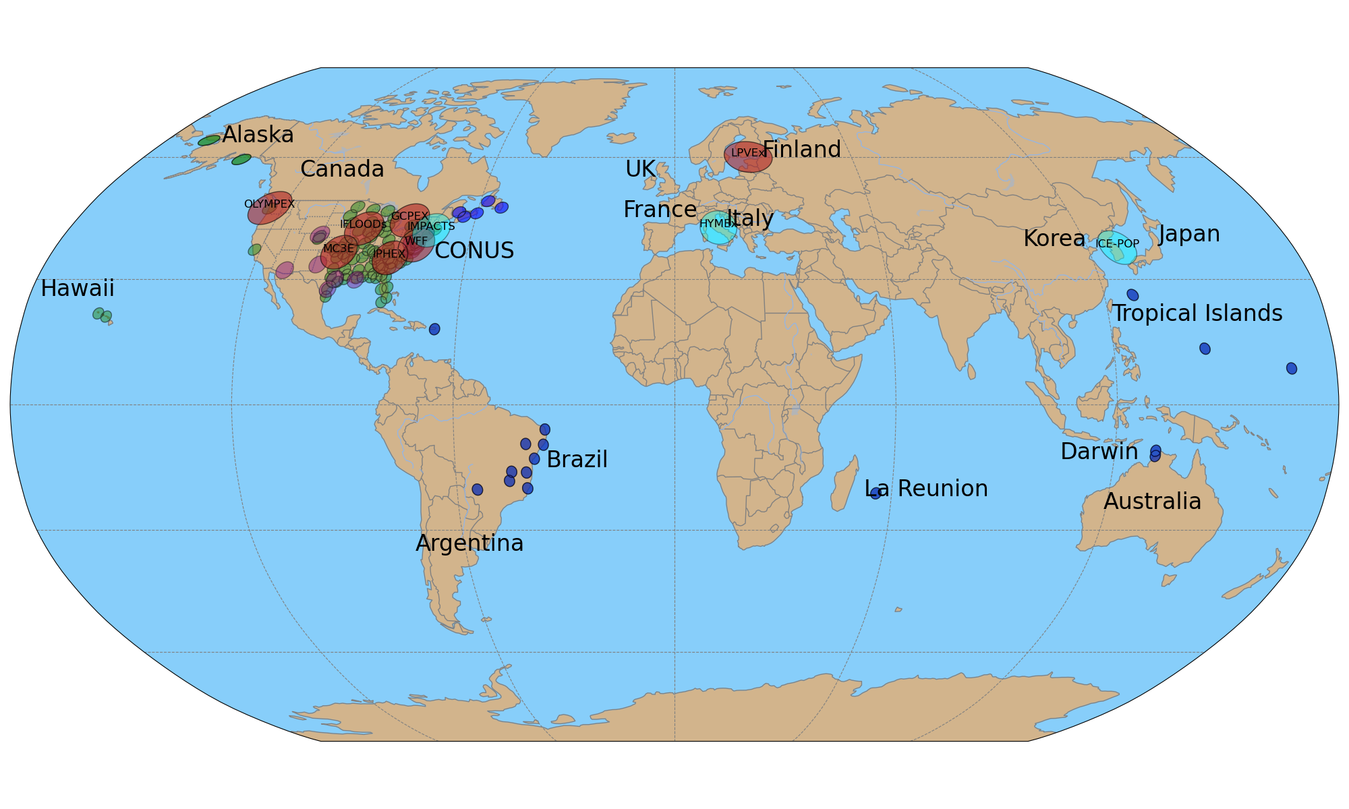
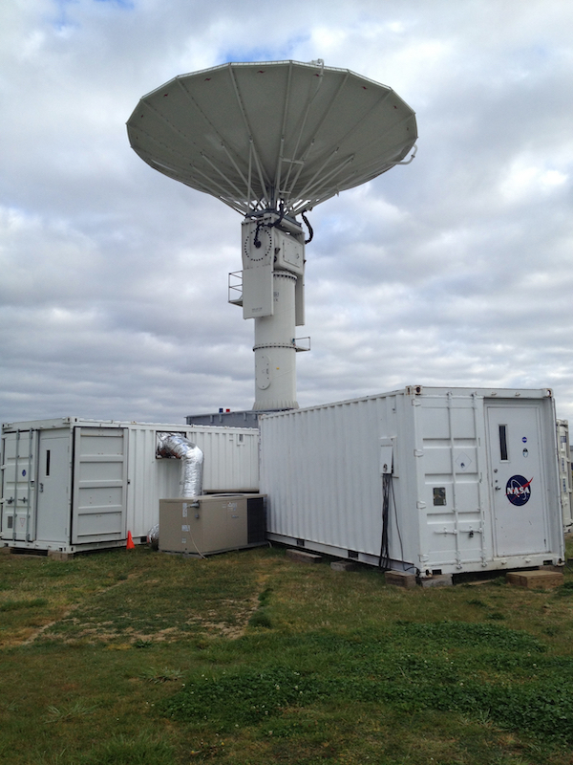
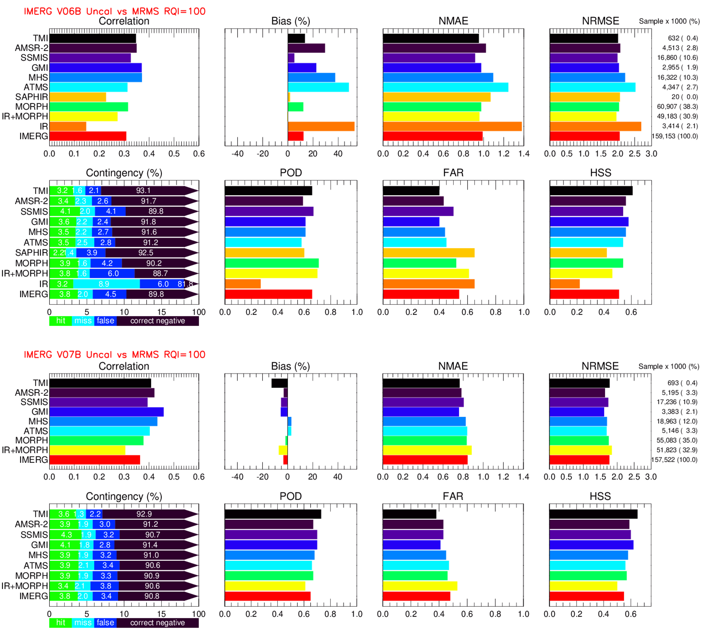
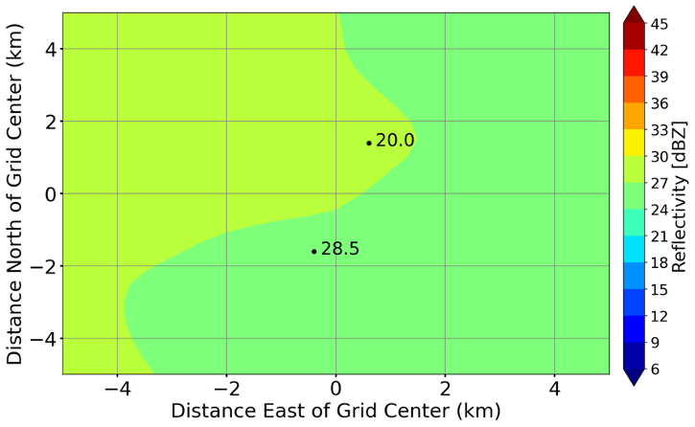
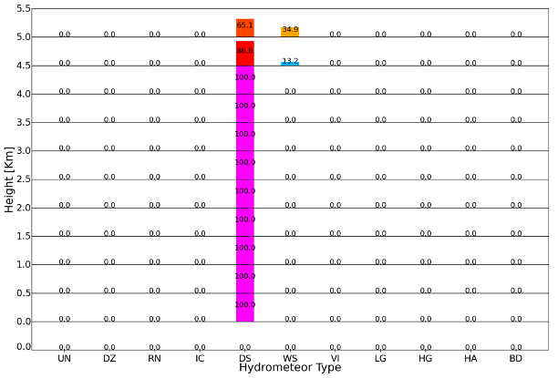
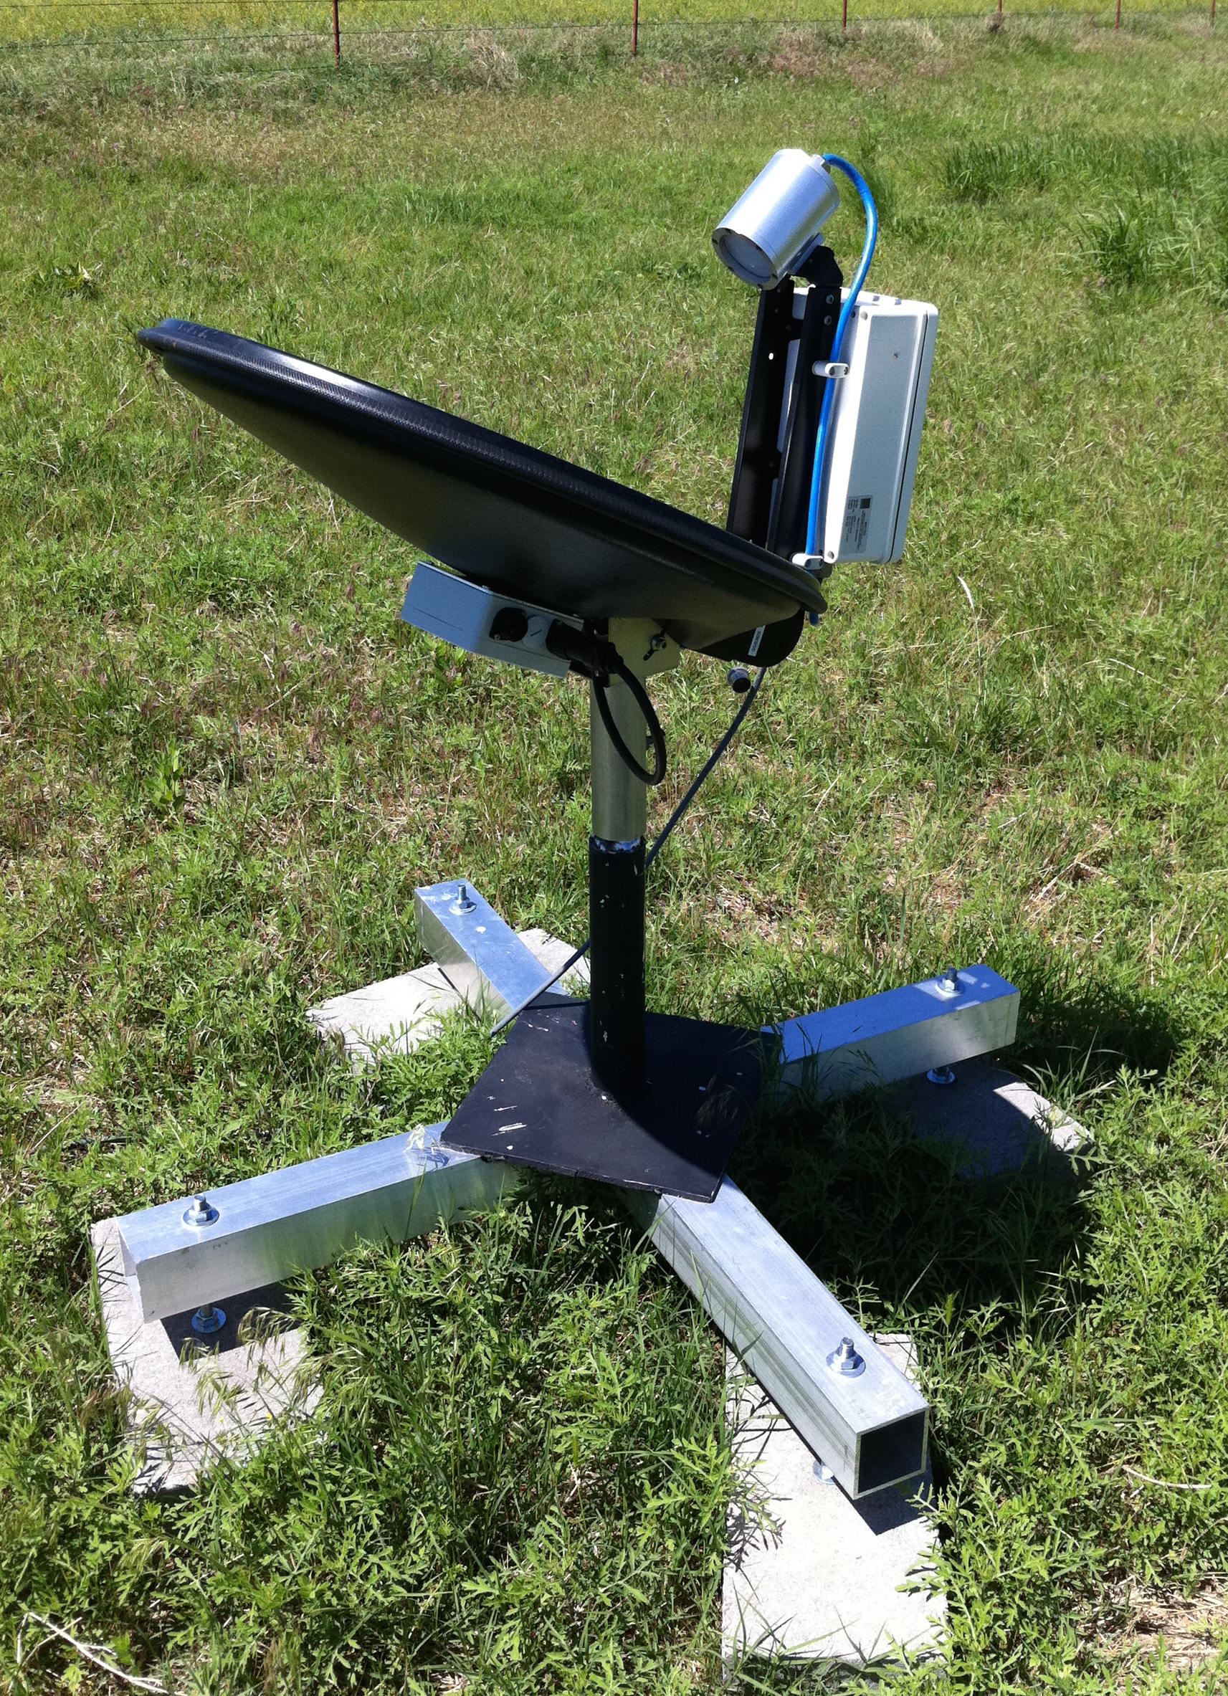
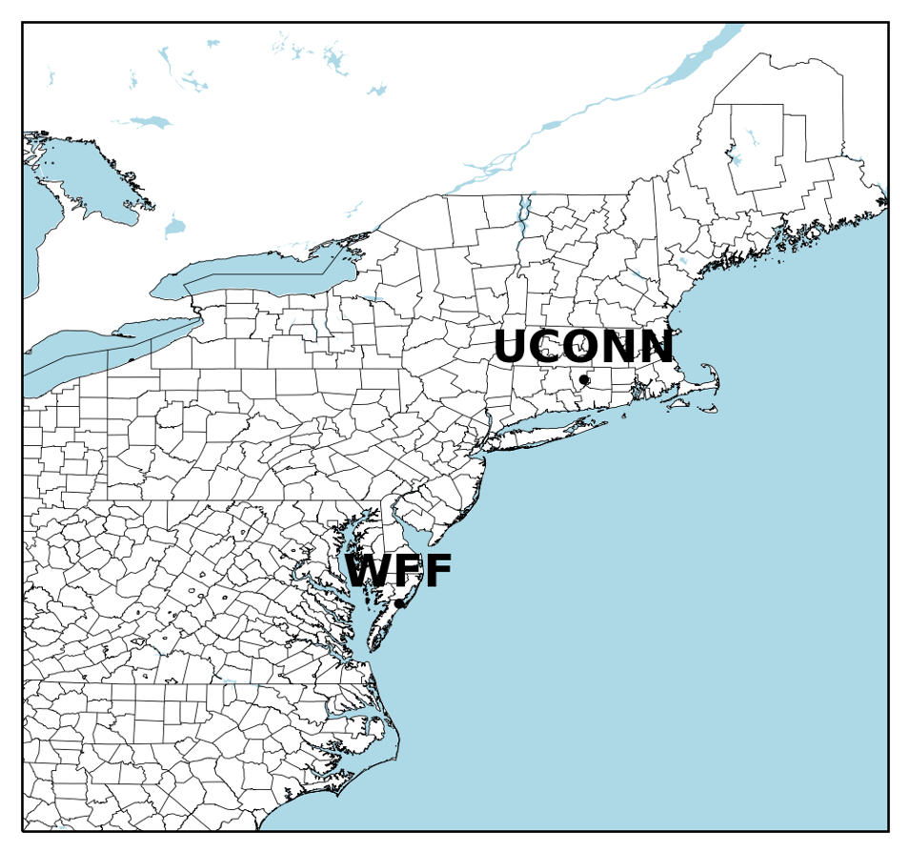
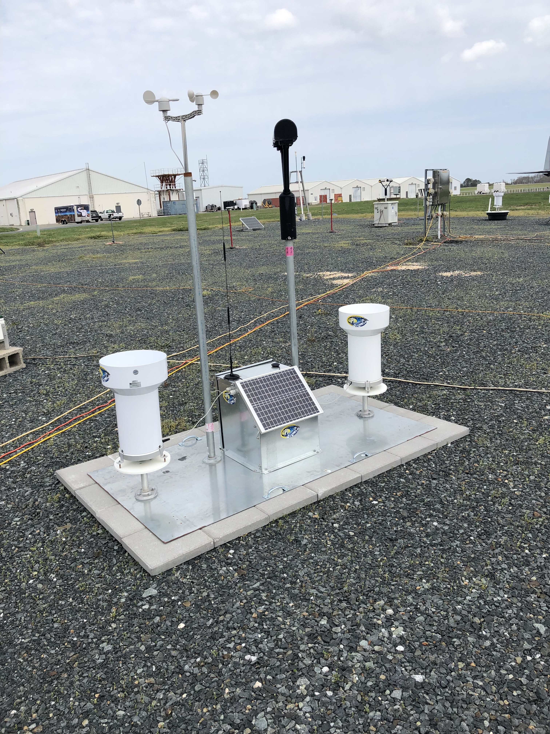

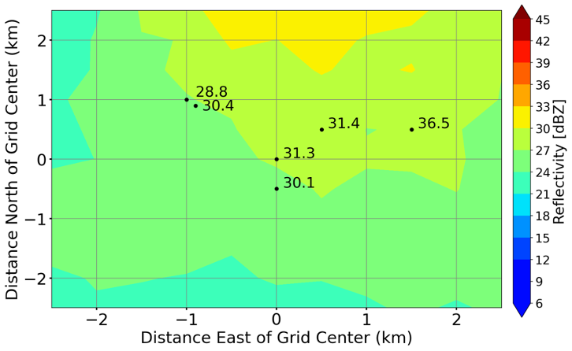
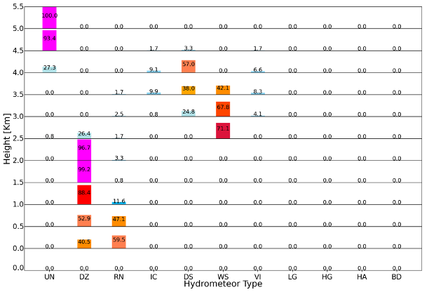
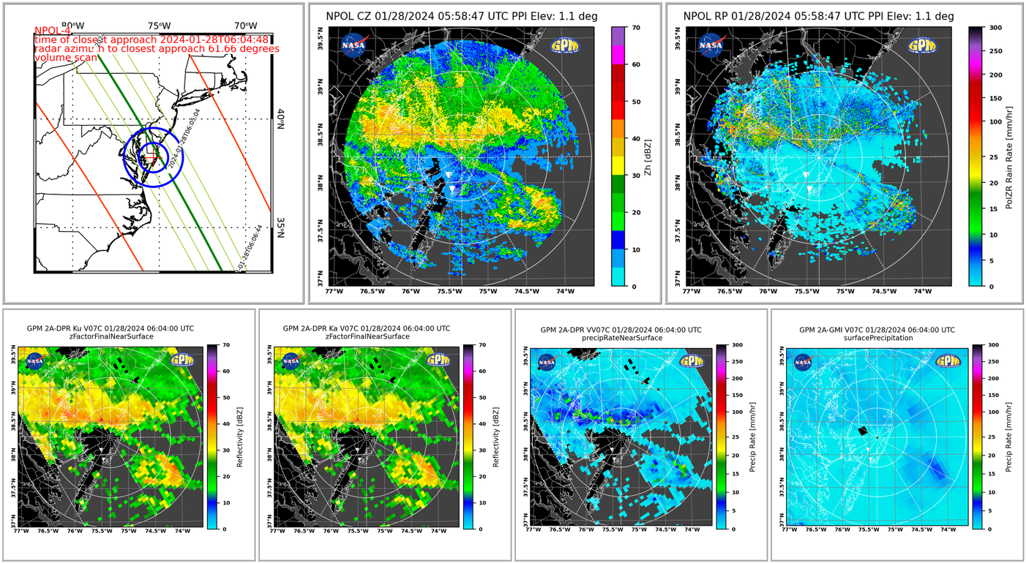
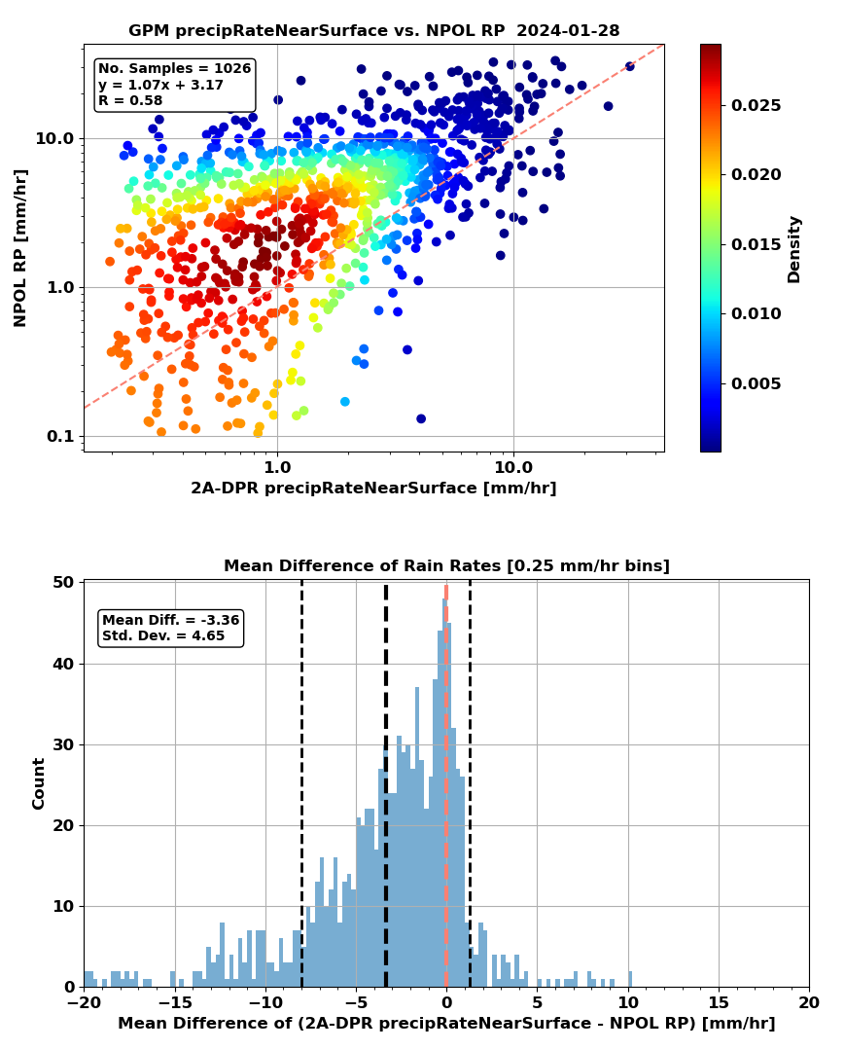


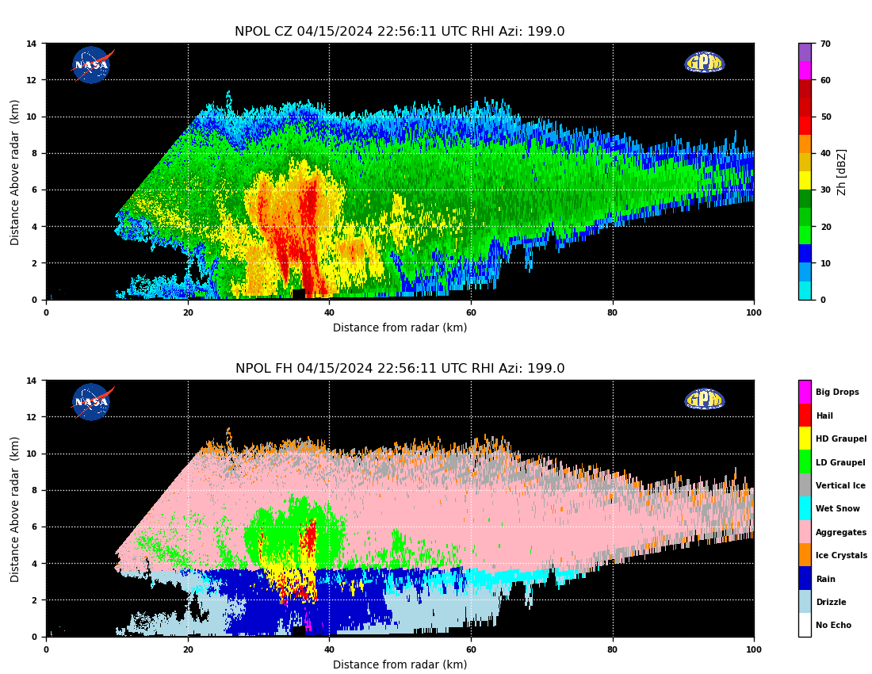
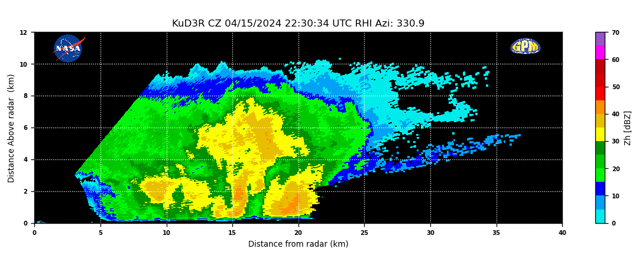
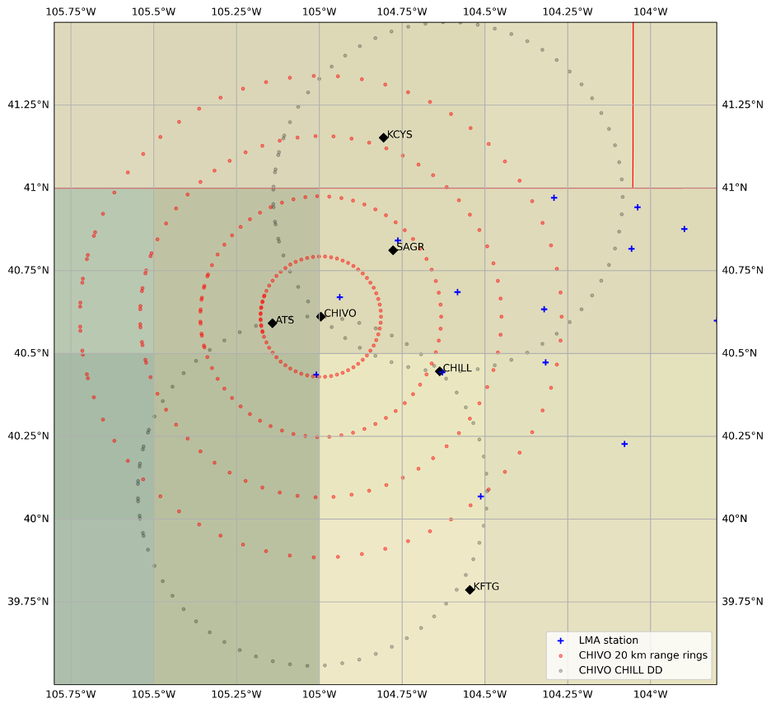
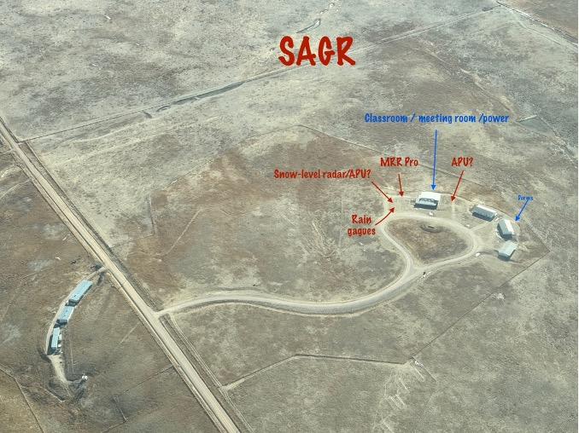
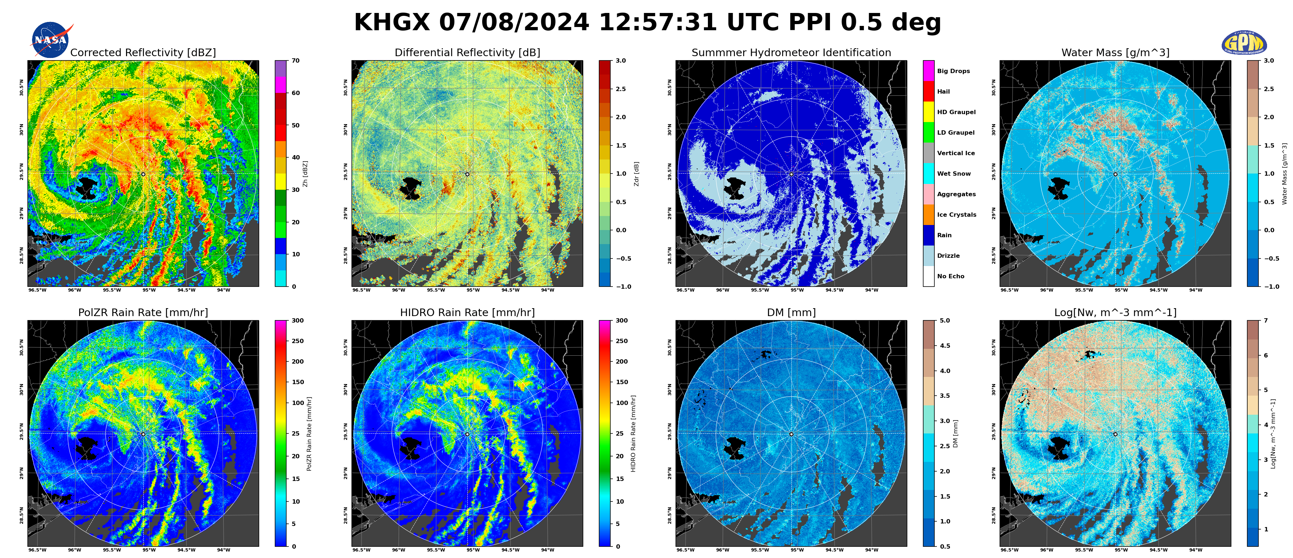
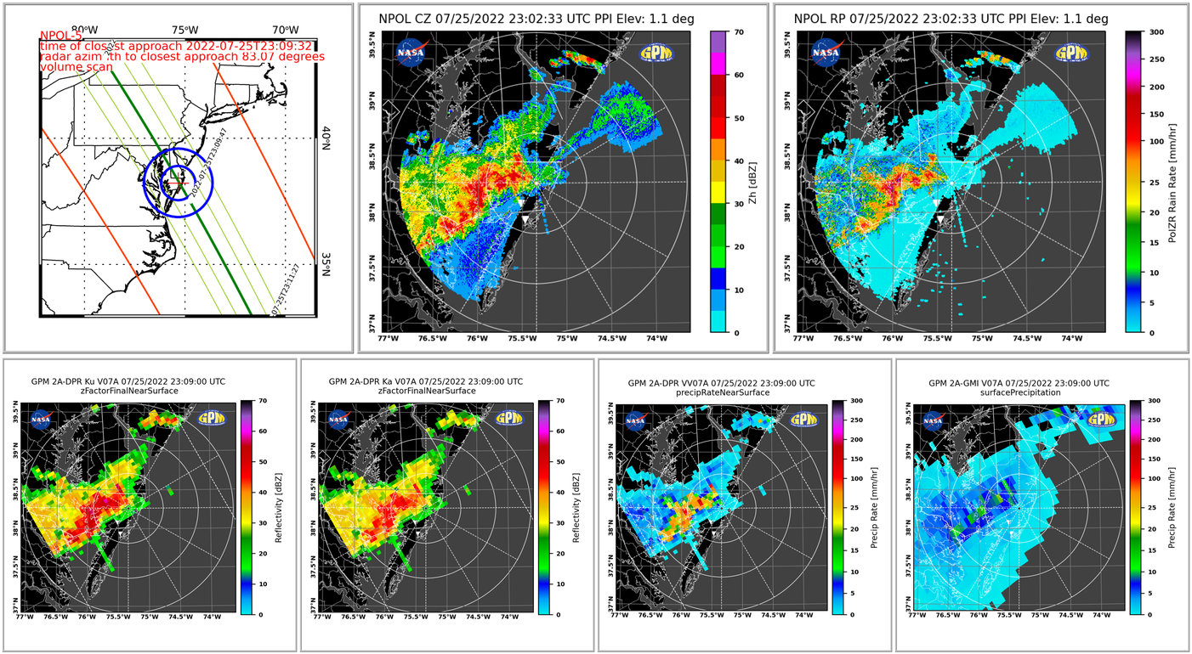
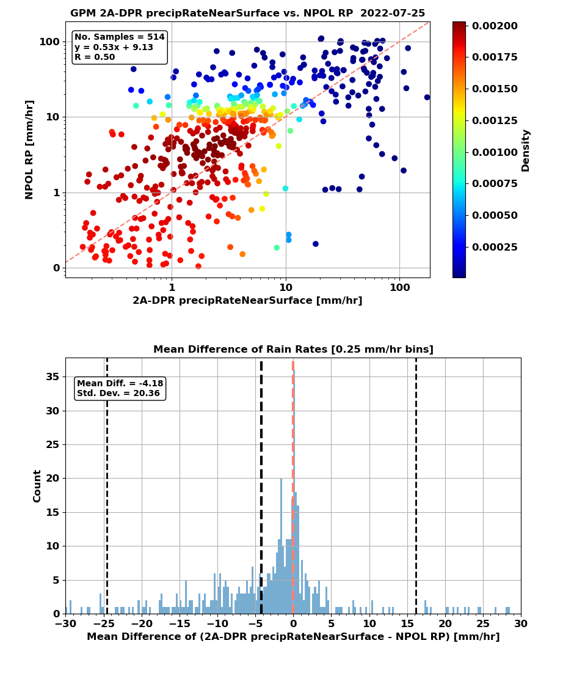
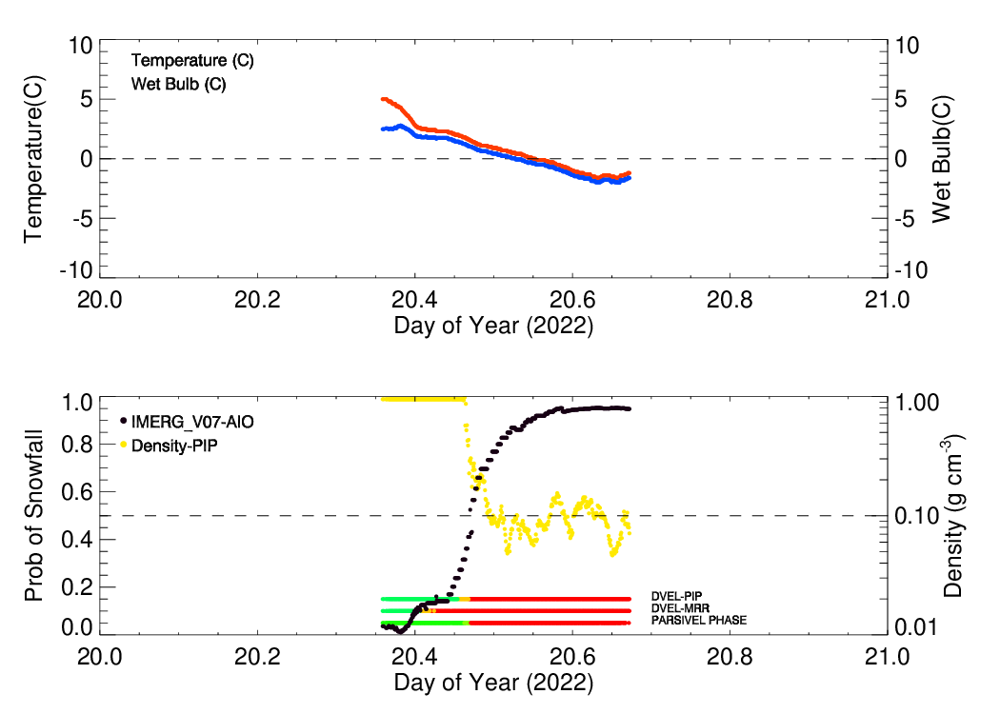

GPM Ground Validation at 10+ Years
David B. Wolff¹, Charanjit Pabla^{1,2}, Jason Pippitt^{2,3}, Jianxin Wang^{2,3}, Alexey Chibisov^{1,5}, Mick Boulanger^{1,2}, Ali Tokay^{3,4}
¹NASA Wallops Flight Facility, Wallops Island, VA, USA; ²Science Systems and Applications, Inc., Lanham, MD, USA
³NASA Goddard Space Flight Center, Greenbelt, MD, USA; ⁴University of Maryland Baltimore County, Baltimore, USA; ⁵McCallie Associates Inc., Bellevue, NE, USA
GPM Global Network
IMERG Comparisons
Python System for Integrating Multiplatform Data to Build the Atmospheric Column (pySIMBA)
KBOX Reflectivity
Snow
throughout
the column
Disdrometer Reflectivity
The GPM GV network truly is global!
The GPM Validation Network currently consists of 80 CONUS and 21 international individual sites. GSFC provides quality control of the radar data, and MSFC executes the VN software to match GV observations to GPM retrievals.
Through an international partnership with Environment and Climate Change Canada, NASA’s GPM-GV group ingests and processes five Eastern Canadian Radars.
GPM GV supports eight different Minority Serving Institutions (MSI) in support of a NASA HQ goal to increase participation of MSI in Earth Science Division (ESD) STEM education.
GPM-GV python based GVradar package used for processing of ground-based radars and retrievals
GPM GV seeks partnerships with other groups and institutions to deploy and participate in synergistic field campaigns such as Snow Sensitivity to Clouds in a Mountain Environment (S2noCLiME), IMPACTS, and TIME-SLICE CO
GPM GV recently developed a fully automated Platform for In Situ Estimation of Rainfall Systems (PIERS) with two rain gauges; PIERS+ which also contains a Parsivel2 disdrometer; and PIERS++ which adds a RM Young All-in-One instrument for measuring wind speed, wind direction, as well as temperature, pressure and relative humidity. Each platform is powered by solar panels and transfers data every 15 minutes to NASA servers.
Two examples of SIMBA columns:
Top: Example from Investigation of Microphysics and Precipitation for Atlantic Coast Threatening Snowstorms (IMPACTS)
Bottom: Example from NASA Wallops
The HID as a function of height shows the probability of hydrometeor type at each level in the grid for the two ground-based radars.
NPOL Reflectivity
Statistical metrics for each source in IMERG V06B and V07B over the period of Jun 2014 to Aug 2021. (Top): Pearson correlation coefficient (correlation), relative bias (bias), normalized mean absolute error (NMAE), and normalized root mean square error (NRMSE). (Bottom): contingency table with hit (green), miss (aqua), false alarm (blue), and correct negative (black). Probability of detection (POD), False alarm ratio (FAR) and Heike skill score (HSS) are also displayed. The numbers at the right are the numbers of matched samples and their percentages of the total samples with conditions of precipitation rates at least 0.1 mm h−1 (upper panel). The evaluation demonstrates the clear improvement in IMERG V07B precipitation product in comparison with V06B in terms of precipitation detection, systematic bias, and random bias.
GPM Precipitation Research Facility Status
Disdrometer Reflectivity
Melting Snow
A key asset for the GPM GV Program is the GPM Precipitation Research Facility (PRF) located at near NASA Wallops Flight Facility in Wallops Island, VA. The PRF currently hosts a variety of ground-based and remote-sensing instruments for studying precipitation physics and microphysics. The lynchpin instrument is NASA’s Polarimetric radar (NPOL) located approximately 38 km NNE of the Wallops main base in Newark, MD.
The PRF hosts numerous other instruments including several disdrometers (Parsivel2, 2DVD, MPS), Micro Rain Radars (MRR-2 and MRRPro), Precipitation Imaging Package (PIP), MetOne and RMYoung All-in-One, Campbell Scientific Weather Tower and numerous precipitation gauges (tipping bucket and Pluvio).
Radar Processing with GVradar
Satellite Calibration & Validation
REAL-TIME APPLICATION
NPOL
GVradar retrieves RAP model sounding data, allowing QC and products to be generated in near real-time.
D3R
GPM GV Assets Assist Synergistic Field Campaigns
Testing INCUS Methods Experiment – Suborbital preLaunch
Investigations of Convective Evolution in Colorado
(TIME-SLICE CO)
The primary goals of the INvestigation of Convective Updrafts (INCUS) mission are:
To determine the predominant environmental properties controlling convective mass flux in tropical convective storms
The relationship between convective mass flux and high anvil clouds
The relationship between convective mass flux and the type and intensity of the extreme weather produced
TIME-SLICE CO will build an initial proving ground to determine the types of data needed to validate products for the NASA EV-3 Investigation of Convective Updrafts (INCUS) mission.
[Courtesy https://incus.colostate.edu/mission/overview]
Comparisons of NPOL (ground-based radar) and DPR (spaceborne radar) rain rate retrieval methods during overpasses in both stratiform (top) and convective (bottom) rain events . The use of ground-based radar and a network of automated disdrometers and tipping buckets allows for near real-time calibration and validation of the GPM satellite and it's derived products. The network hosts three grids capable of validating resolutions 0.5° x 0.5°, 5 km x 5 km, 0.5 km x 0.5 km, and can be tuned to any footprint using standalone PIERS+ platforms. Collaboration with
educational institutions under the Improved Participation of Minority Serving Institutions (IPMSI) campaign has further expanded the network across the nation, enabling students to obtain experience with NASA instrumentation while simultaneously contributing to the GPM mission.
Hurricane Beryl
A)
B)
A) Sites associated with the TIME SLICE experiment. NASA instruments will be located at the SAGR. B) aerial view of the SAGR site with proposed locations for the requested instruments. NASA has provided the campaign and MRR Pro, and a PIERS+ precipitation station for the campaign.
[Courtesy Brenda Dolan]
GPM/GV IMPACTS Field Campaign
Between the years 2022-2023, GPM GV deployed several instruments to Storrs, CT in collaboration with the University of Connecticut and in support of, originally, NASA’s Investigation of Microphysics and Precipitation for Atlantic Coast-Threatening Snowstorms (IMPACTS) field campaign. An additional deployment was during winter of 2023-2024, and another will begin December 2024 through April 2025.
The image to the left shows a rain-to-snow event on January 20, 2022. A very good agreement between the PIP density and Doppler velocity algorithms is evident. PARSIVEL phase transition occurs slightly later while MRR Doppler velocity algorithm predicts snow earlier. The period of sharp drop off in PIP density matches well with the sharp increase in IMERG probability of snow, which is based on All-In-One weather station wet-bulb temperature.
Precipitation products generated include HIDRO Rain Rate (RC), Pol ZR Rain Rate (RP), Hydrometeor Identification (FH), Ice and Liquid mass (MI, MW), mass weighted mean diameter (Dm), and normalized intercept parameter (Nw).
Acknowledgements
We would like to thank the GPM Wallops Precipitation Research Facility engineers (Mike Watson and Edward Hickman) and technician staff for installing, calibrating, and maintaining ground precipitation platforms. This research is funded by Dr. George Huffman (NASA GPM Project Scientist).
GPM-GV Python packages can be found on Git Hub: https://github.com/GPM-GV/

